Slide 1






KONGU ENGINEERING COLLEGE
PERUNDURAI ERODE-638060
ARTIFICIAL INTELLIGENCE AND DATA SCIENCE
Big Data Analytics Project
Used Bike Price Analysis
In association with:
Team Members: Manjupargavi S (21ADR027)
Sabari S (21ADR042)
Vignesh T (21ADR060)

Slide 2


The Problem
Lack of analysis may result in an inefficient market where buyers and sellers are unaware of fair market values, leading to potential overpricing or underpricing of used bikes.
Buyers may make uninformed decisions, paying more than necessary or purchasing bikes with hidden issues. Sellers may struggle to set competitive prices, impacting their ability to sell.
Failure to analyze trends means missing out on valuable insights into market dynamics, such as popular models, depreciation rates, or shifts in consumer preferences.

Slide 3
The Solution
Examine historical data related to used bikes price based on its factors to uncover hidden insights, without specifying a particular analysis or solution approach.
Collect, preprocess, and analyze historical data to provide valuable insights and recommendations for buyers, markets and sellers.
The analysis aims to identify trends, assess the impact of various features, and facilitate informed decision-making in the used bike marketplace.

Slide 4
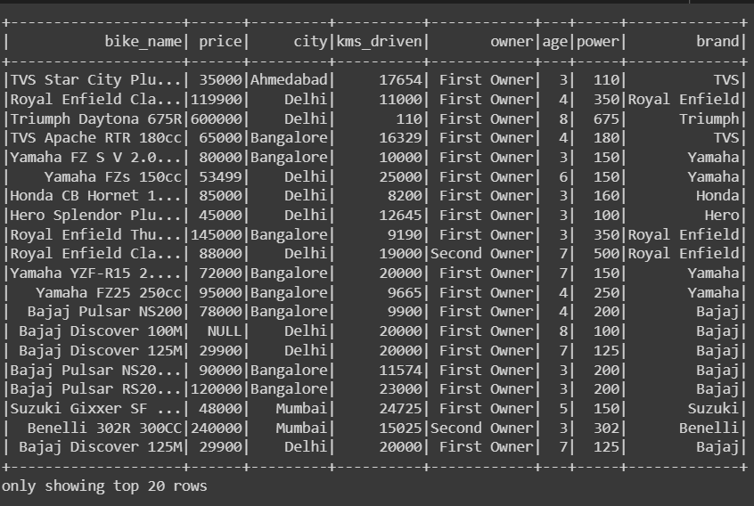
Dataset
Used bikes.csv from kaggle

Slide 5
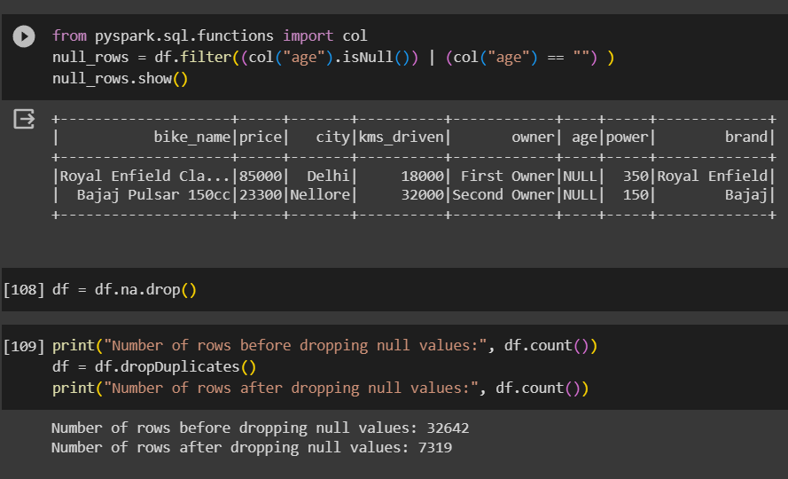
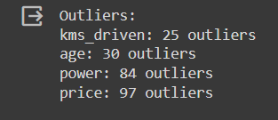
Preprocessing

Slide 6
PREPROCESSING
The null values present in the dataset has been removed by using the function df.drop.na
The duplicates instances have been removed using the function df.dropDuplicates
The outliers has been identified using the z score by setting the threshold value as default 3.
The outliers are handled using the log transform mechanism.

Slide 7
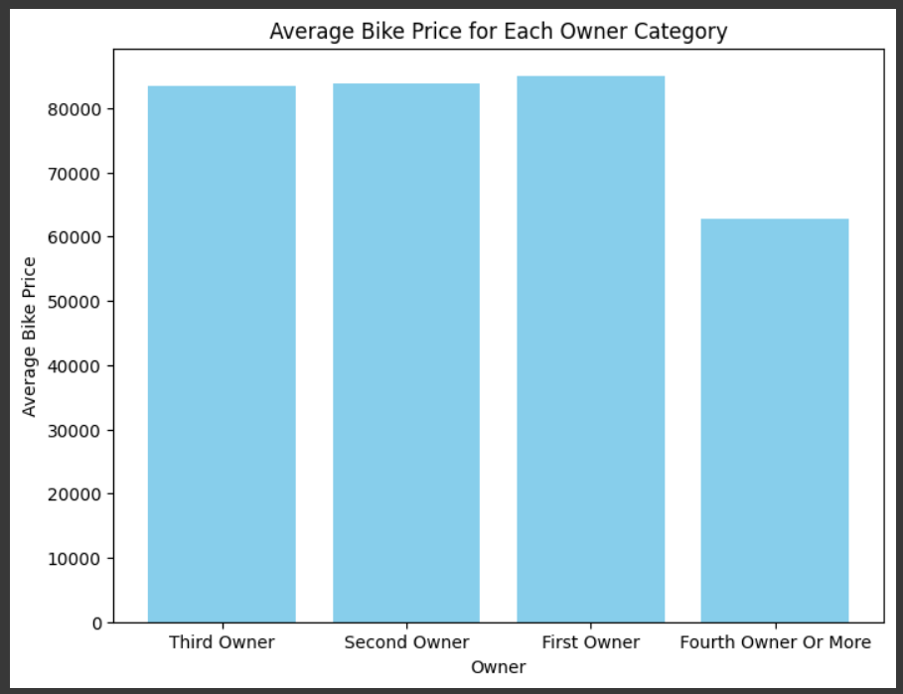
INSIGHTS

Slide 8
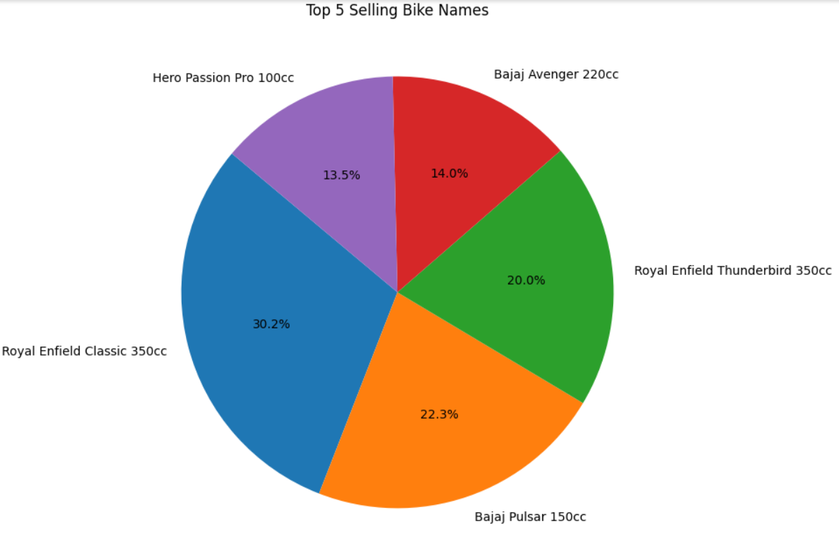

Slide 9
FEATURE ENGINEERING
String indexer is used in this project to transform the categorical columns into numerical indices.
Feature hasher is used to convert the large unique values presented categorical values into numerical indices by setting the target as 100.
Vector assembler is used to combine the multiple features into single vector to prepare the input for ml algorithm.

Slide 10
ML MODELS WITH PIPELINE
Linear regression
Decision tree regressor
Random forest regressor
OPTIMIZATION TECHNIQUES
Hyperparameter tuning
Cross validation with 5 folds

Slide 11
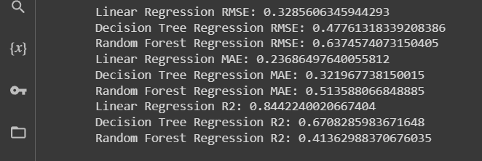
Algorithm Summary

Slide 12
Algorithm Accuracy Summary
Linear regression: Achieved the best rmse score among the other models with 0.3
Decision tree: Performed well with an 0.4 rmse score
Random Forest: Showed the lowest rmse score with 0.6, indicating potential room for improvement or the need to further investigate the model or data.

Slide 13
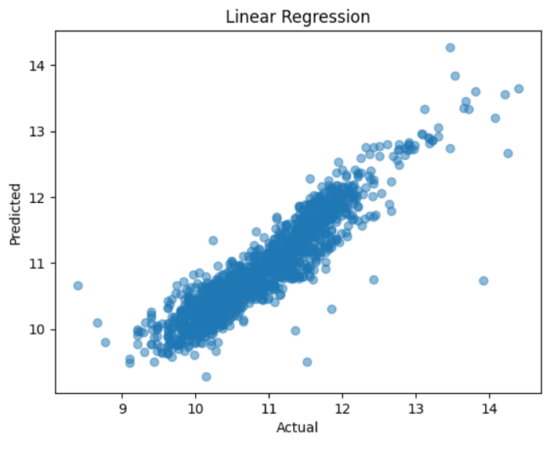
Model performance plot

Slide 14
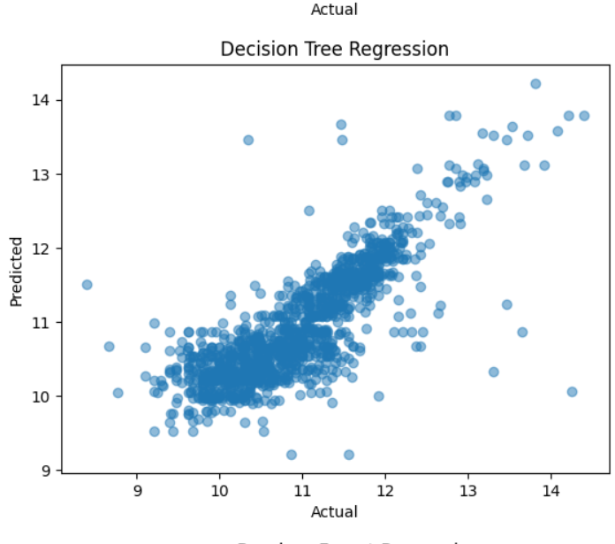

Slide 15
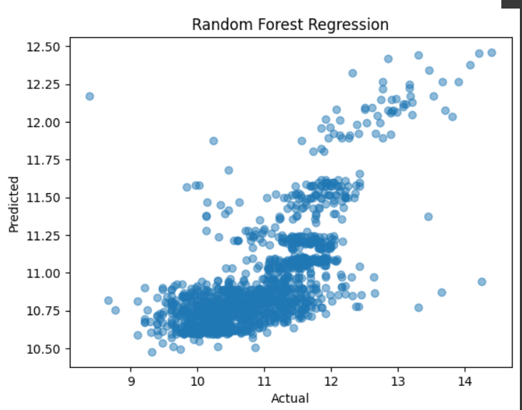

Slide 16
CONCLUSION
The increased prices of new bikes and the financial incapability of the customers to buy them, Used bike sales are on a global increase.
Therefore, there is an urgent need for a Used Bike Price Prediction system which effectively determines the worthiness of the car using a variety of features.
The proposed system will help to determine the accurate price of used bike price prediction. This project provide the linear regression as the best model

Slide 17
Thank You !!

